Slide 1
Chapter 15: Glaciers & Erosion
Perito Moreno Glacier, Argentina

Slide 2
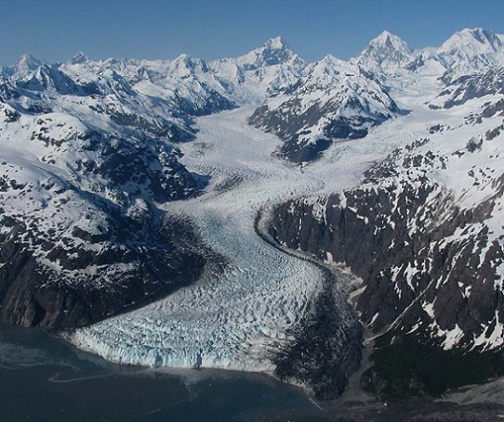
glaciers – masses of moving ice (typically hundreds of meters thick)
Margerie Glacier (Glacier Bay National Park), Alaska

Slide 3
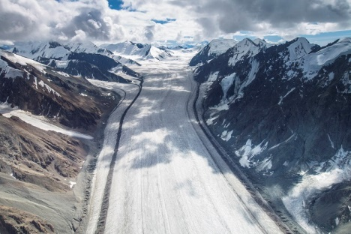
Two Main Types of Glaciers:
Valley glacier (or alpine glacier) – long, slow-moving, wedge-shaped stream of ice
Fraser Glacier, Alaska

Slide 4
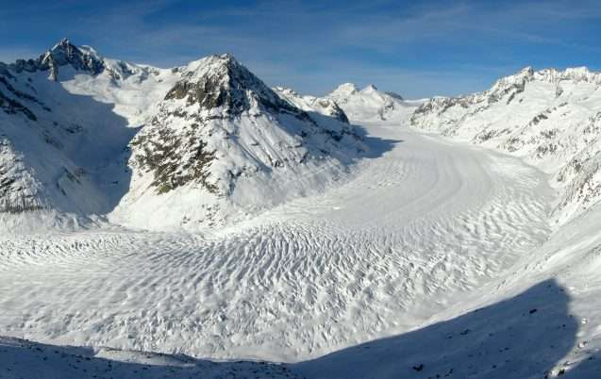
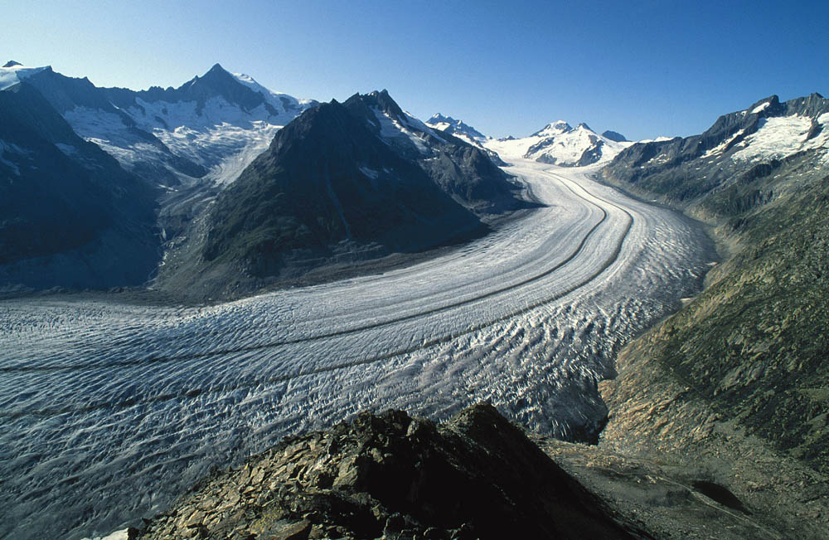
Aletsch Glacier, Switzerland – largest valley glacier in the Alps

Slide 5
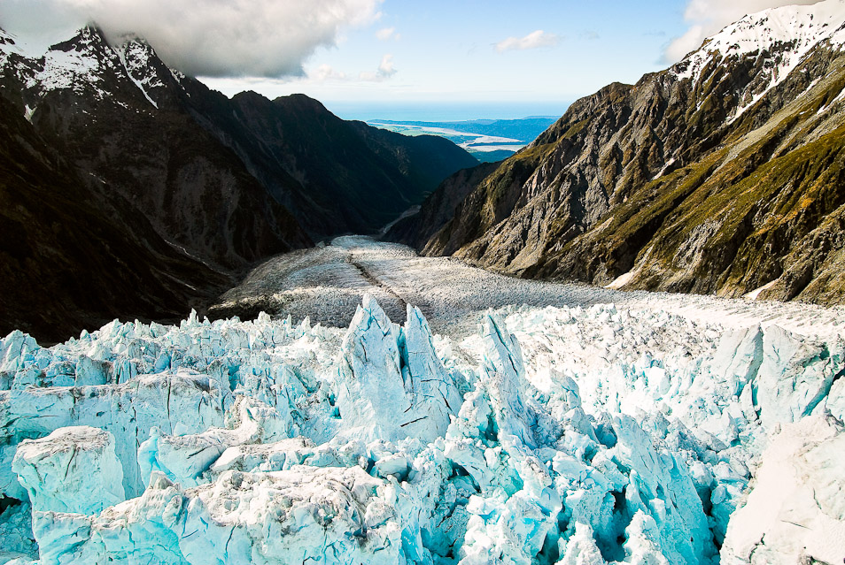
Formed in mountainous areas like coastal Alaska, the Himalayas, the Andes, the Alps, and New Zealand
New Zealand glacier

Slide 6
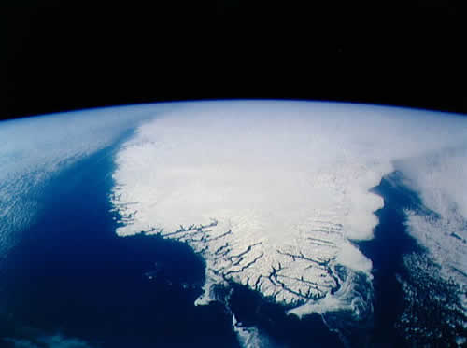
Two Main Types of Glaciers:
Continental ice sheets – larger glacier that moves through low valleys
Greenland

Slide 7
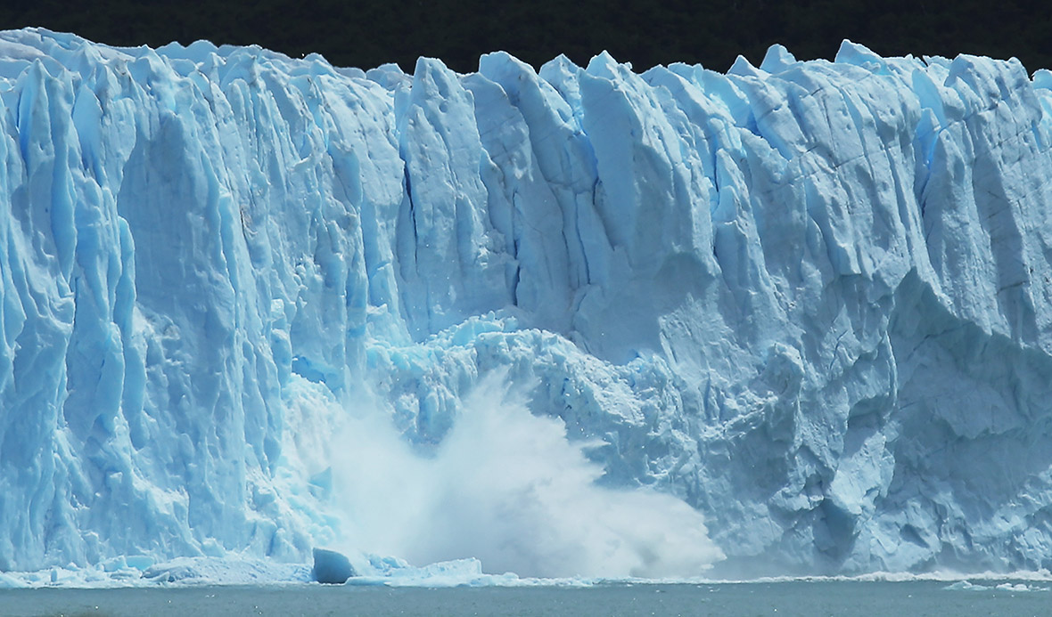
May calve (or break off to form icebergs in the ocean)

Slide 8
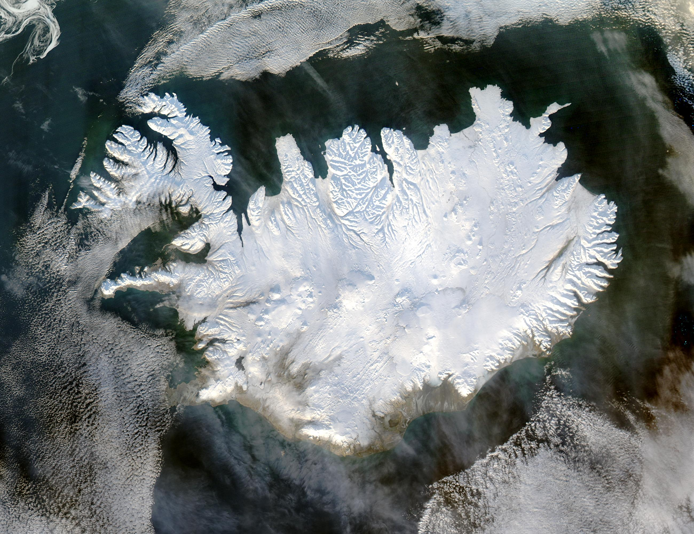
Large ice sheets are called ice caps.
Iceland via Satellite

Slide 9
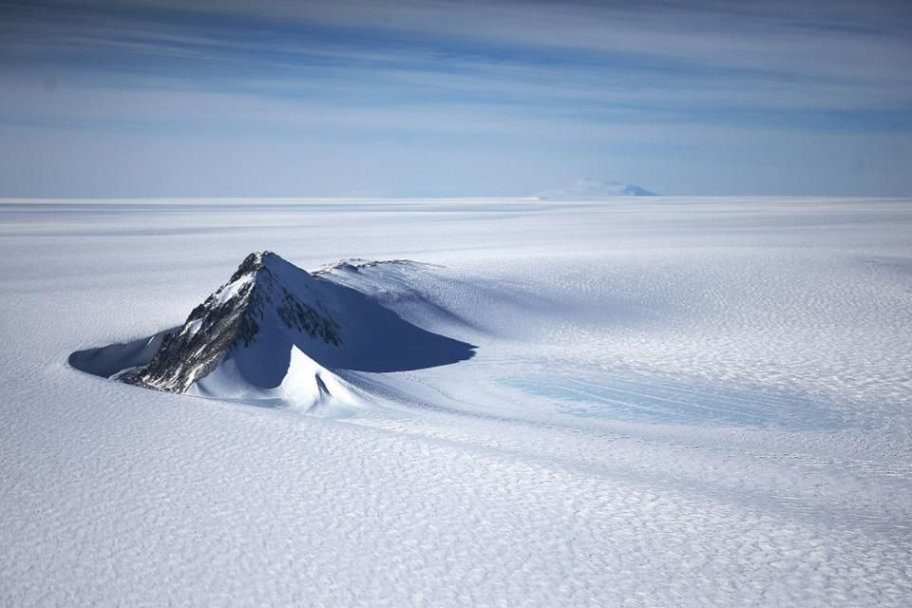
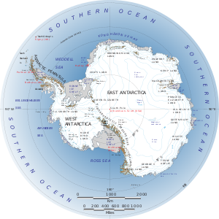
Only located in Greenland and Antarctica.

Slide 10
If melted entirely, these continental ice sheets would raise the world wide sea level by more than 60m. What effect would this have on humans?

Slide 11
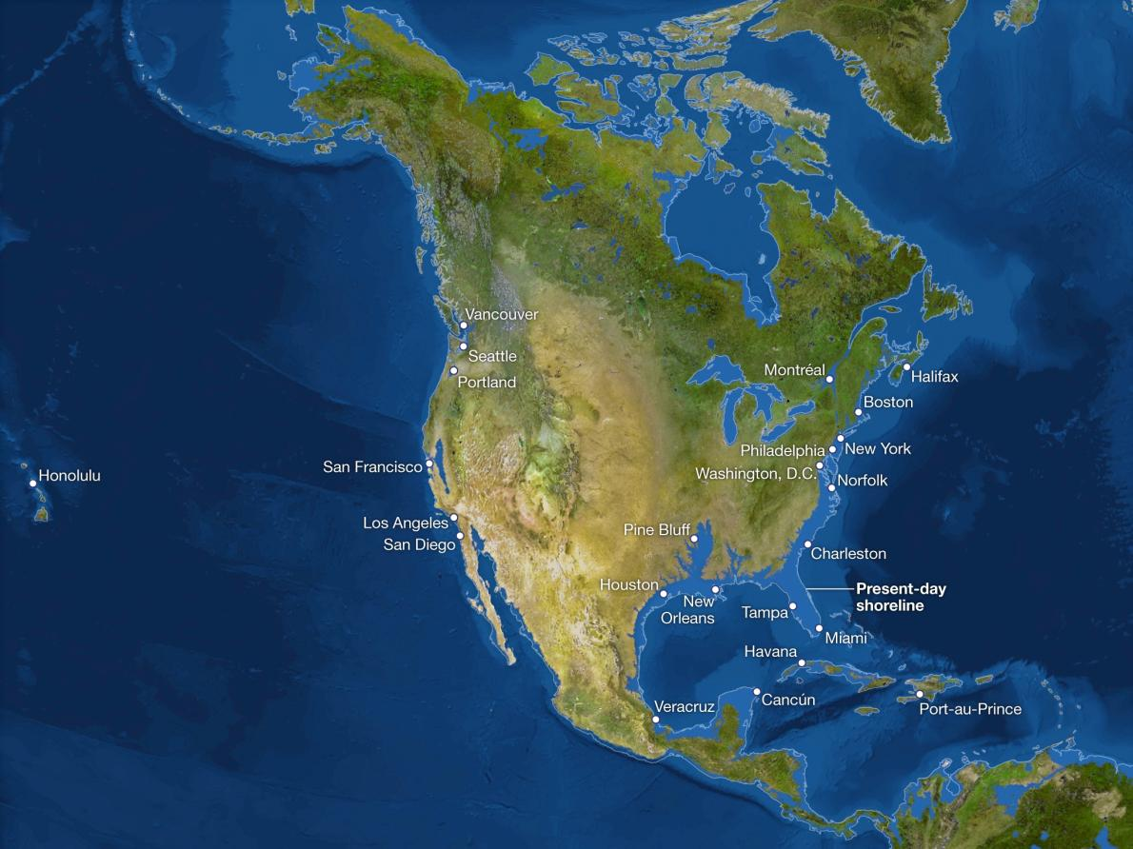
If all the ice melted…

Slide 12
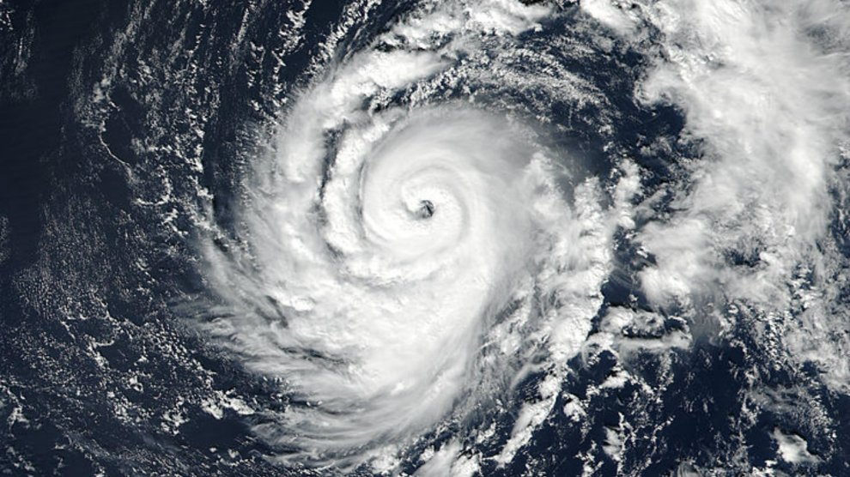

Slide 13
So, how do you make a difference?

Slide 14
Drive a fuel efficient car
Make your house more air tight
Eat local and buy meat from energy-efficient companies (do your research!)
Turn off and unplug appliances when not in use
Change your light bulbs
Wash clothes in cold water
Buy less stuff
Let policy makers know you are concerned about global warming
Spread the word and stay informed

Slide 15
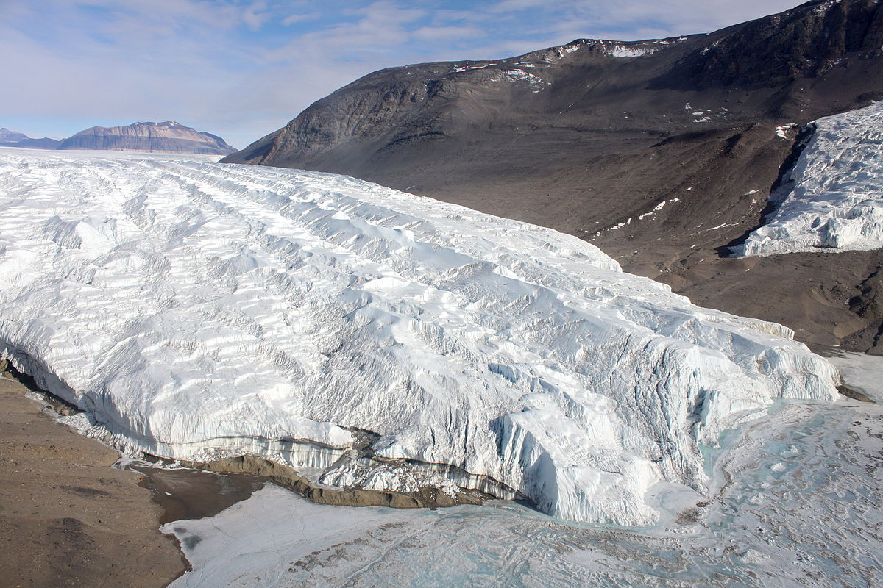
How Do Glaciers Form?
When snow and ice accumulate to a great enough thickness that the ice starts to move downslope due to gravity, a glacier is formed.
Taylor Glacier, Antarctica

Slide 16
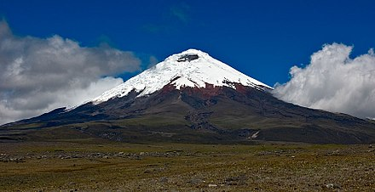
This occurs above the snowline – the elevation above which ice and snow remain throughout the year.

Slide 17
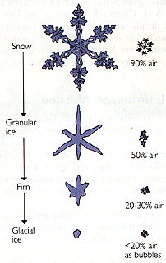
As snow accumulates above the snowline, it becomes compressed and recrystallizes into rough ice crystals called firn.

Slide 18
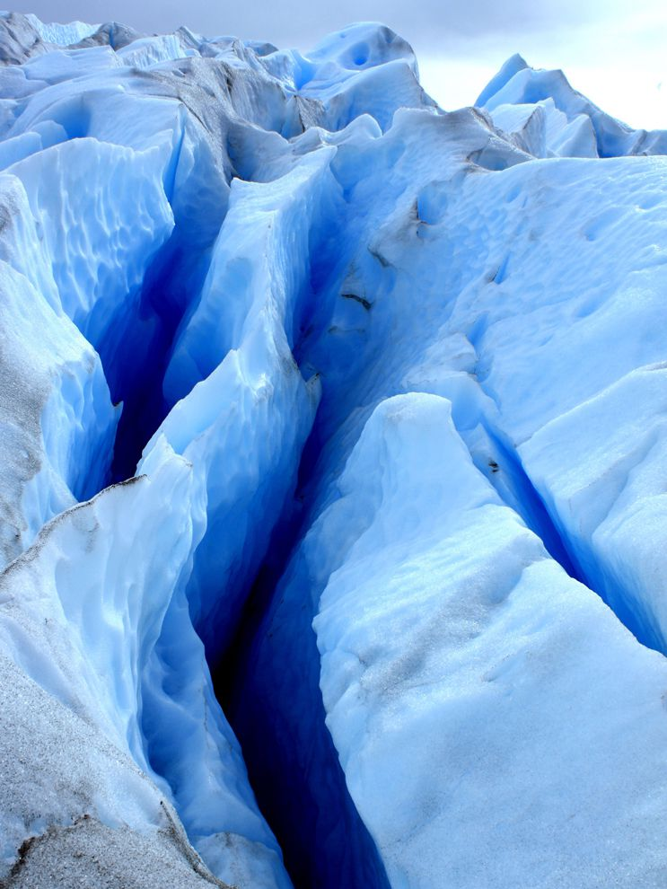
The deepest layers becomes so compressed that the air is squeezed out of the firn ice crystals, which causes its color change from white to steel-blue.
Crevasse on Perito Moreno Glacier, Argentina

Slide 19
Glaciers should “recede” in the summer and “advance” in the winter. Was that the case according to the film we watched? Why?

Slide 20
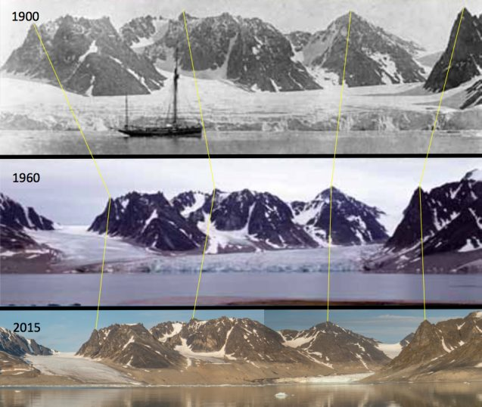
Waggonwaybreen Glacier, Svalbard, Norway

Slide 21
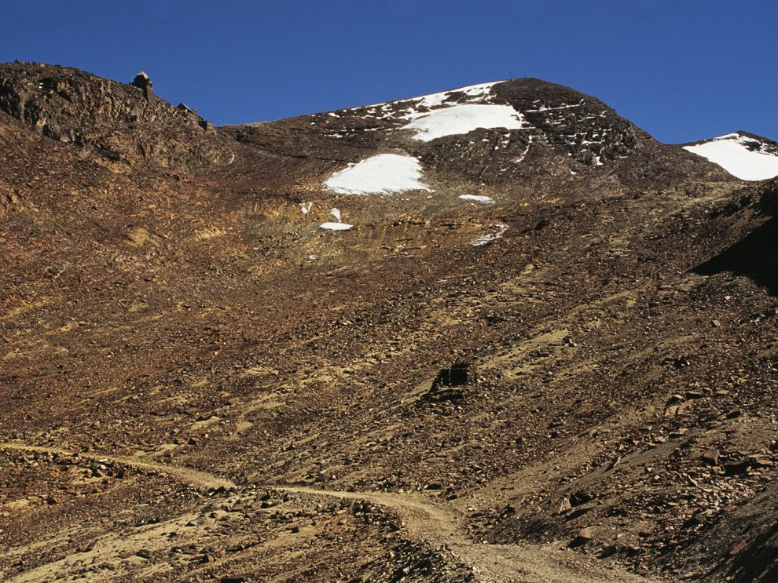
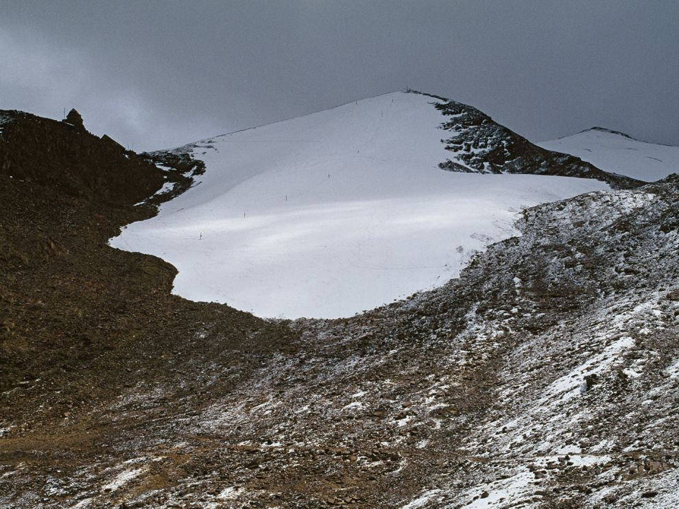
Chacaltaya Glacier, La Paz, Bolivia

Slide 22
Climate change – a change in global or regional climate patterns
Climate change is attributed mainly to increased levels of atmospheric carbon dioxide (CO₂) produced by the use of fossil fuels.

Slide 23
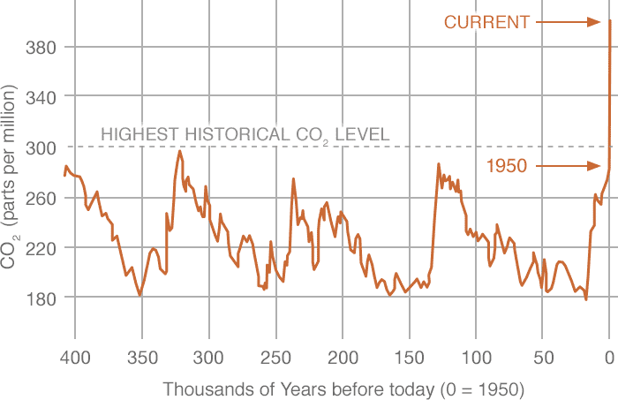

Slide 24
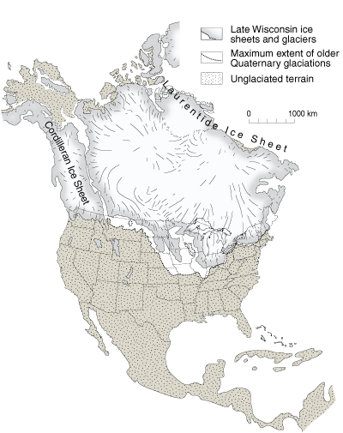
An ice age is a long period of climatic cooling during which continental ice sheets cover large areas of the earth’s surface.

Slide 25
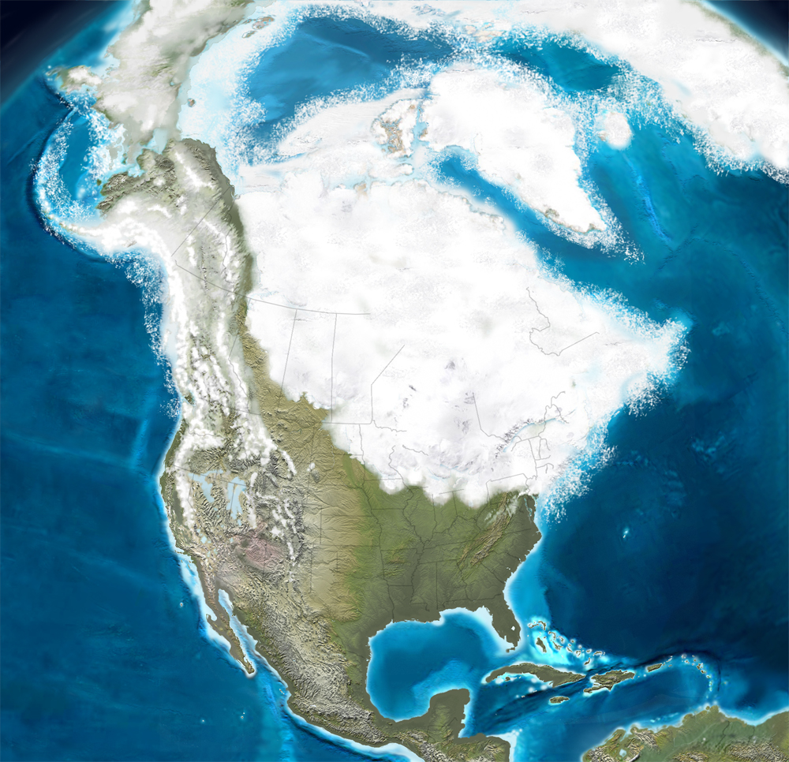

Slide 26
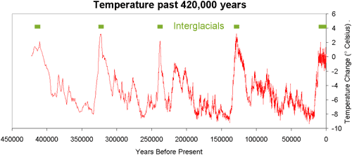
What Causes an Ice Age?
A long-term decrease in the earth’s average temperature. A drop of about 5°C with an increase in snowfall could trigger an ice age.

Slide 27
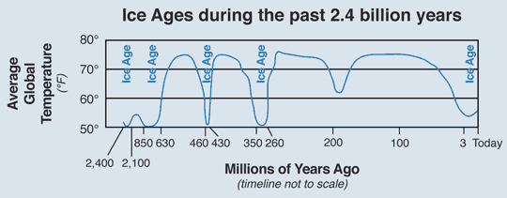
There have been several ice ages throughout earth’s history. The last major Ice Age ended 11,000 years ago. 30% of all the land area was covered by ice.

Slide 28
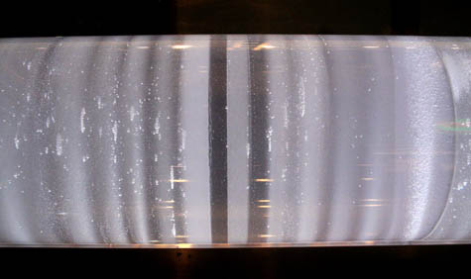
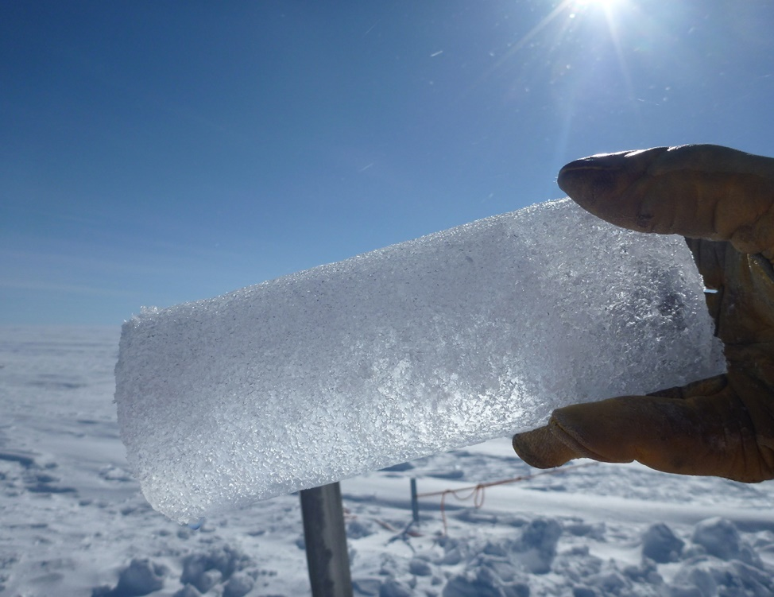
How Do You Know This?
Ice Cores

Slide 29
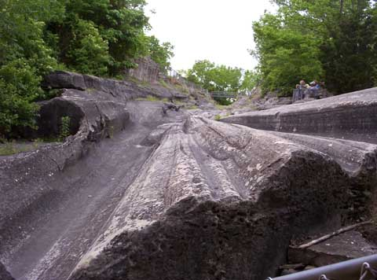
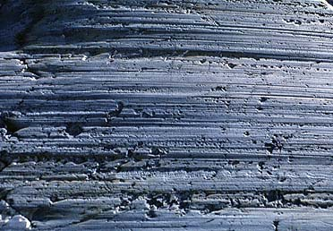
How Do You Know This?
Glaciers carry large boulders that scratch bedrock as it passes.

Slide 30
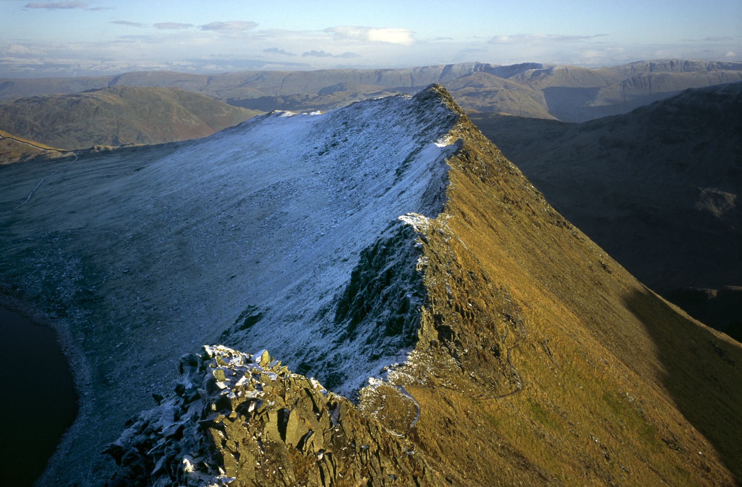
How Do You Know This?
Glacial features like arêtes, horns, tills, kettles, moraines, erratics, drumlins, etc.
arêtes – sharp mountain ridges created by glaciers

Slide 31
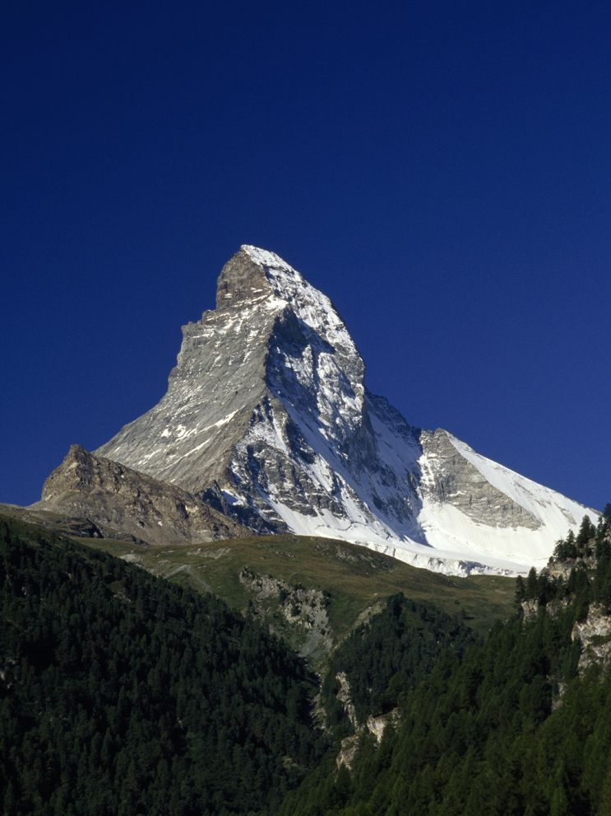
Matterhorn, Switzerland – Glacial horn (formed as three or more glaciers meet, forcing the land between them up into a peak)

Slide 32
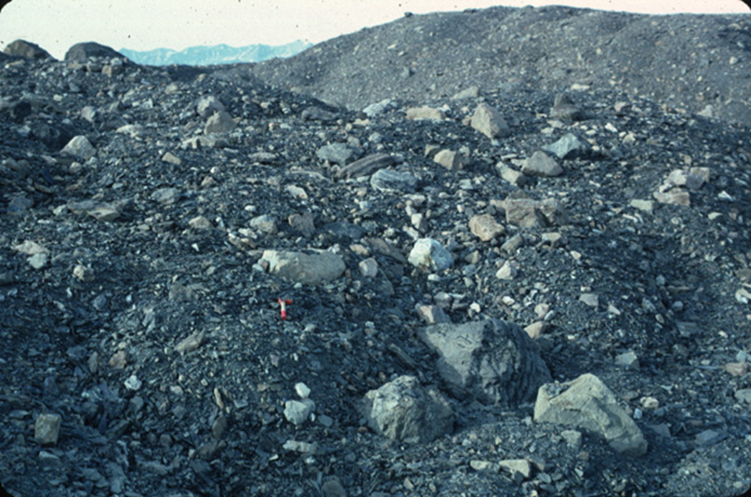
Tills – sediment deposited by glaciers

Slide 33
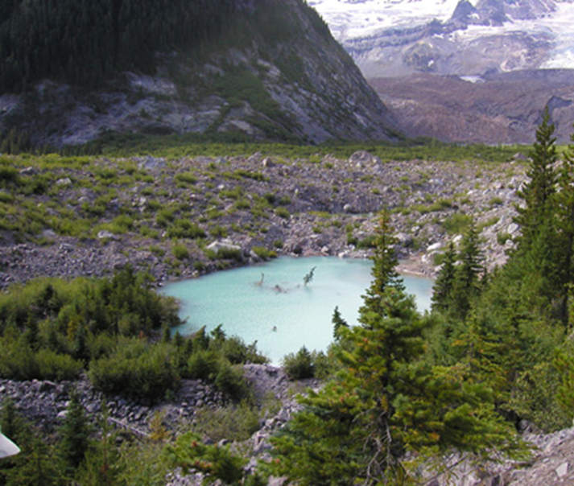
Kettles – contain water that melted off of glaciers

Slide 34
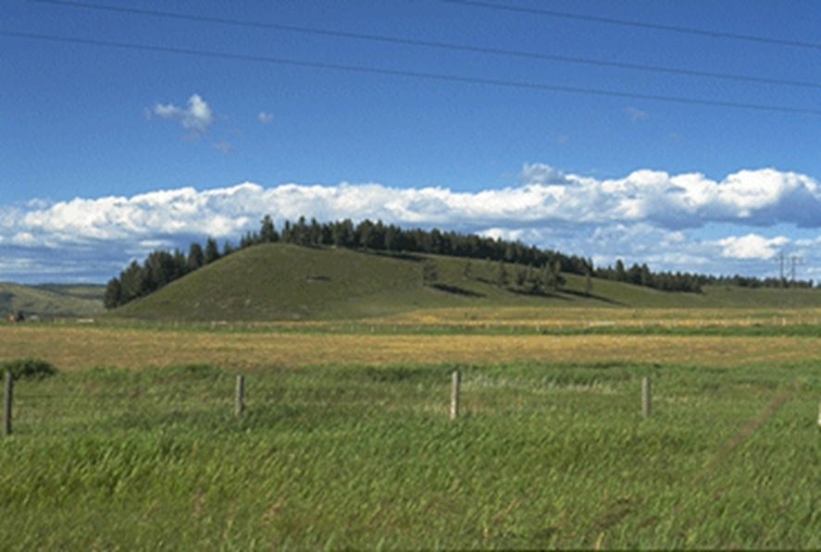
Drumlins – low, oval hills consisting of compacted boulder clay that were molded as the glacier advanced and receded over the area

Slide 35
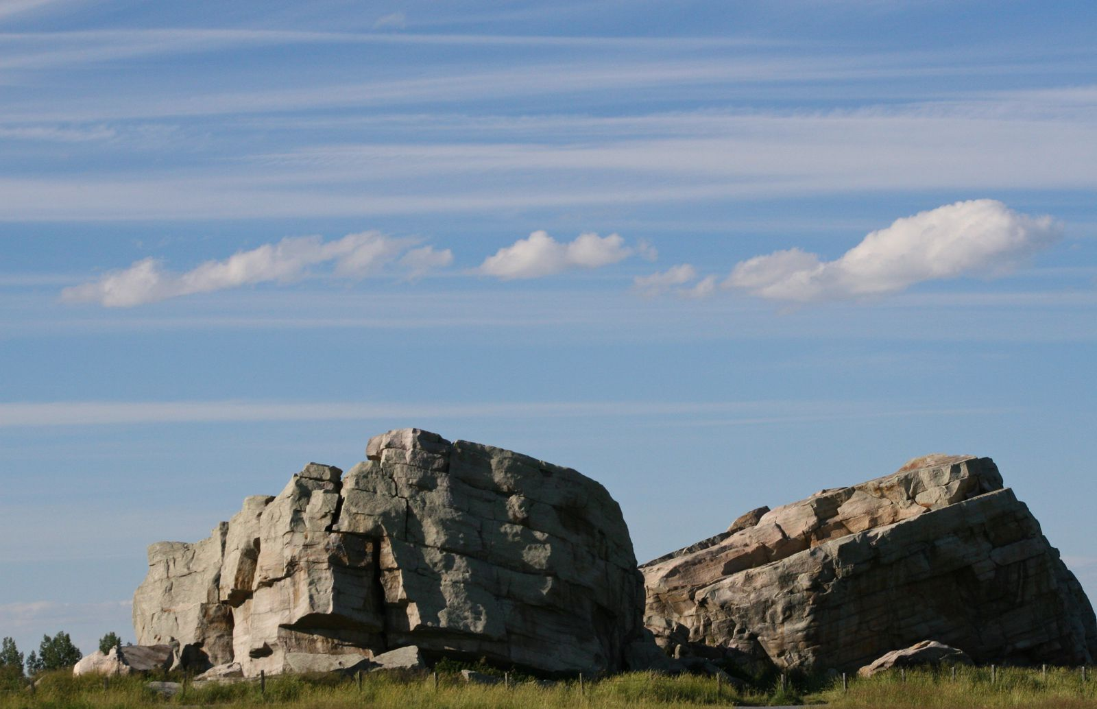
Erratics – rocks or boulders (differing from surrounding rock) that have been carried along by glaciers

Slide 36
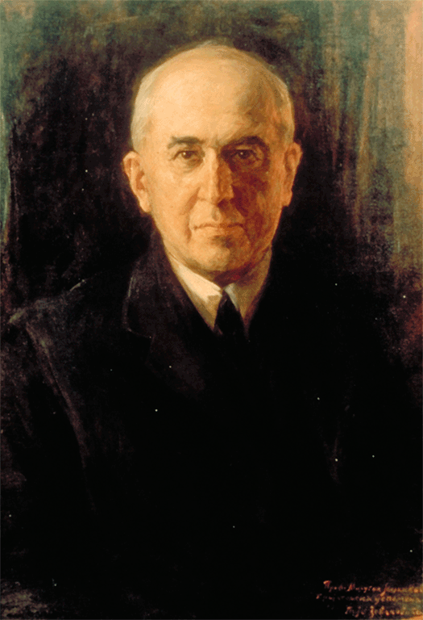
What Causes the Temperature Drop that Initiates an Ice Age?
Serbian scientist Milutin Milankovitch proposed the most well-accepted explanation:

Slide 37
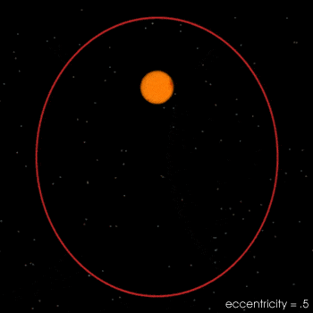
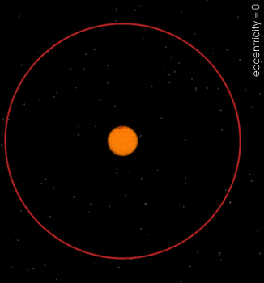
Earth’s orbit fluctuates from circular to elliptical and back about every 100,000 years.

Slide 38
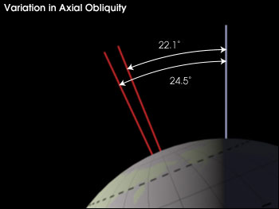
Earth’s tilt varies between 21.5° and 24.5° about every 41,000 years.
This is called obliquity.

Slide 39
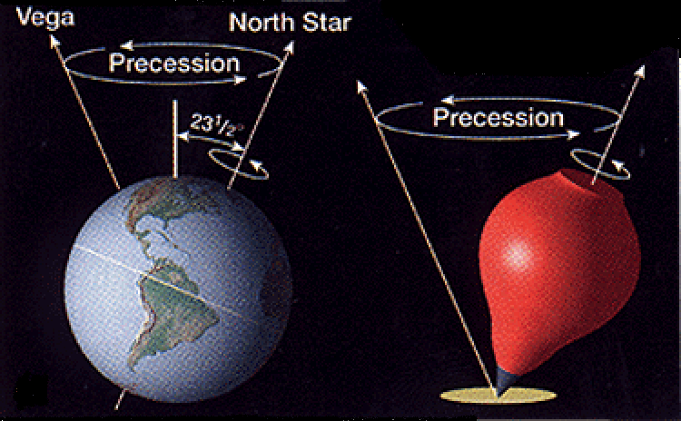
Precession = earth’s axis wobble which makes a full rotation every 26,000 years

Slide 40
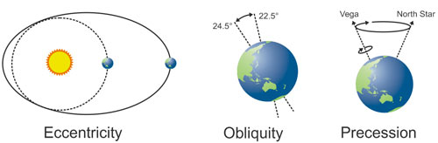
A combination of the three factors above result in a reduced amount of solar energy reaching the earth’s surface.

